Slide 1
Unit 5 -I/O Management
I/O management is a major component of operating system design and operation
  Important aspect of computer operation
  I/O devices vary greatly
  Various methods to control them
  Performance management
  New types of devices frequent
Ports, busses, device controllers connect to various devices
Device drivers encapsulate device details
  Present uniform device-access interface to I/O subsystem

Slide 2
I/O Hardware
Incredible variety of I/O devices
  Storage
  Transmission(network connections, Bluetooth)
  Human-interface(screen, keyboard, mouse, audio in and out)
Common concepts – signals from I/O devices interface with computer
  Port – connection point for device(serial,parallel)
  Bus - daisy chain(A->B->C->port of computer)
    PCI bus common in PCs and servers, PCI Express (PCIe)
    expansion bus connects relatively slow devices
  Controller (host adapter) – electronics that operate port, bus, device
    Sometimes integrated
    Sometimes separate circuit board (host adapter)
    Contains processor, microcode, private memory, bus controller, etc
      Some talk to per-device controller with bus controller, microcode, memory, etc

Slide 3
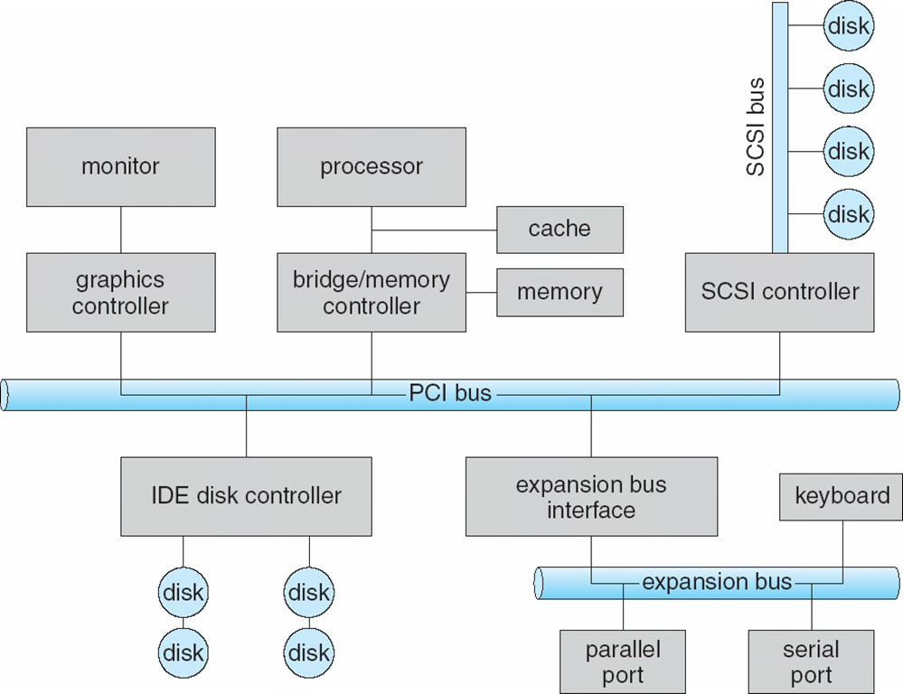
A Typical PC Bus Structure
Small Computer System Interface (SCSI), IDE-Integrated Drive Electronics, PCI-Peripheral Components Interconnect, Serial Advanced Technology Attachment (SATA)

Slide 4
I/O Hardware (Cont.)
I/O instructions control devices
Devices usually have registers where device driver places commands, addresses, and data to write, or read data from registers after command execution
  Data-in register, data-out register, status register, control register
  Typically 1-4 bytes, or FIFO buffer
Devices have addresses, used by
  Direct I/O instructions
  Memory-mapped I/O
    Device data and command registers mapped to processor address space
    Especially for large address spaces (graphics)

Slide 5
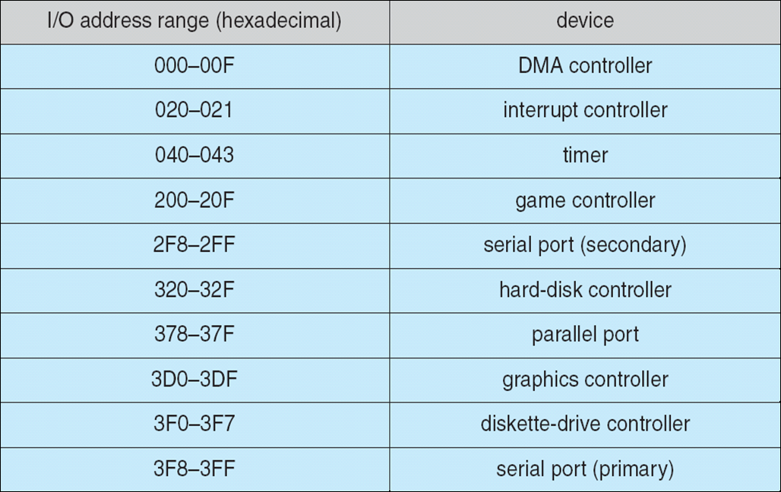
Device I/O Port Locations on PCs (partial)

Slide 6
I/O port registers
The data-in register is read by the host to get input.
The data-out register is written by the host to send output.
The status register contains bits that can be read by the host. These bits indicate states, such as whether the current command has completed, whether a byte is available to be read from the data-in register, and whether a device error has occurred.
The control register can be written by the host to start a command or to change the mode of a device.
For instance, a certain bit in the control register of a serial port chooses between full-duplex and half-duplex communication, another bit enables parity checking, a third bit sets the word length to 7 or 8 bits, and other bits select one of the speeds supported by the serial port.

Slide 7
Polling
Assume that 2 bits are used to coordinate the producer – consumer relationship between the controller and the host.
The controller indicates its state through the busy bit in the status register.
The host signals its wishes via the command-ready bit in the command register.
The host sets the command-ready bit when a command is available for the controller to execute.
For each byte of I/O
  Read busy bit from status register until 0
  Host sets read or write bit and if write copies data into data-out register
  Host sets command-ready bit
  Controller sets busy bit, executes transfer
  Controller clears busy bit, error bit, command-ready bit when transfer done

Slide 8
Polling
Here Step 1 is busy-wait cycle to wait for I/O from device
  Reasonable if device is fast
  But inefficient if device slow
  CPU switches to other tasks?
    But if miss a cycle data overwritten / lost

Slide 9
Interrupts
The CPU hardware has a wire called the interrupt-request line that the CPU senses after executing every instruction.
CPU Interrupt-request line triggered by I/O device
  Checked by processor after each instruction
  When the CPU detects that a controller has asserted a signal on the interrupt-request line, the CPU performs a state save and jumps to the interrupt-handler routine
Interrupt handler receives interrupts
  Maskable to ignore or delay some interrupts
Interrupt vector to dispatch interrupt to correct handler
  Context switch at start and end
  Based on priority
  Some nonmaskable (reserved for events such as unrecoverable memory errors)
  Interrupt chaining if more than one device at same interrupt number

Slide 10
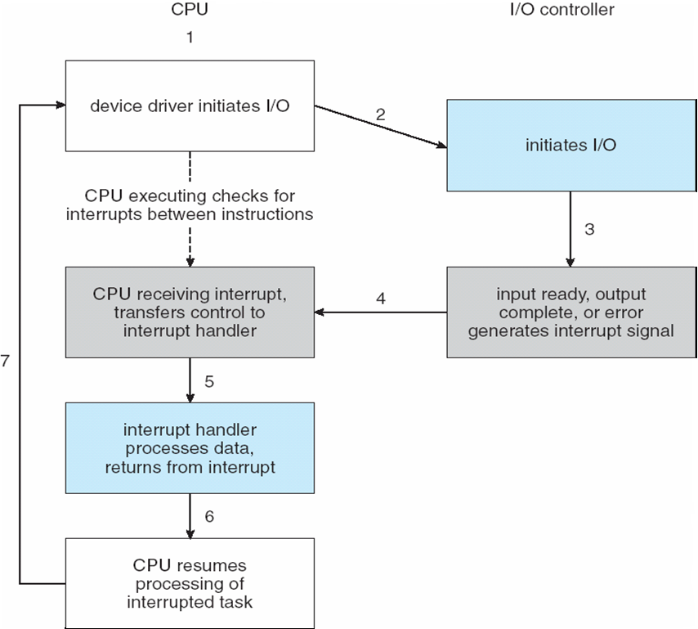
Interrupt-Driven I/O Cycle

Slide 11
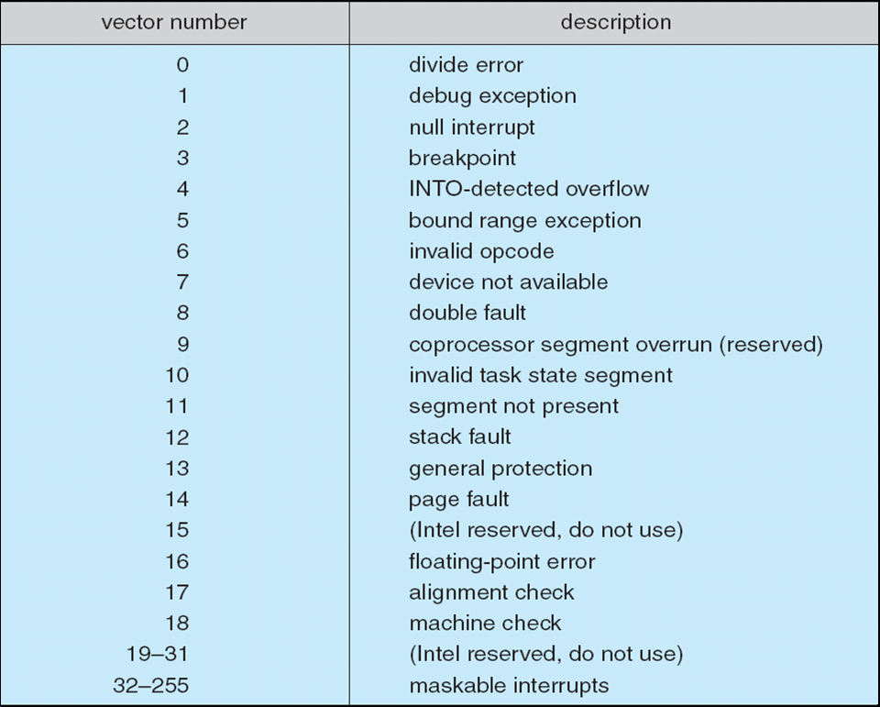
Intel Pentium Processor Event-Vector Table

Slide 12
Interrupts (Cont.)
Interrupt mechanism also used for exceptions
  Terminate process, crash system due to hardware error
Page fault executes when memory access error
System call executes via trap to trigger kernel to execute request
Multi-CPU systems can process interrupts concurrently
  If operating system designed to handle it
Used for time-sensitive processing, frequent, must be fast

Slide 13
Direct Memory Access
Avoid burdening the main CPU with PIO by offloading some of this work to a special-purpose processor called a direct-memory-access (DMA) controller. Used to avoid programmed I/O (one byte at a time) for large data movement
Requires DMA controller
Bypasses CPU to transfer data directly between I/O device and memory
OS writes DMA command block into memory
  Source and destination addresses
  Read or write mode
  Count of bytes
  Writes location of command block to DMA controller
  Bus mastering of DMA controller – grabs bus from CPU
    Cycle stealing(CPU is momentarily prevented from accessing main memory) -but still much more efficient
  When done, interrupts to signal completion
Version that is aware of virtual addresses can be even more efficient - DVMA

Slide 14
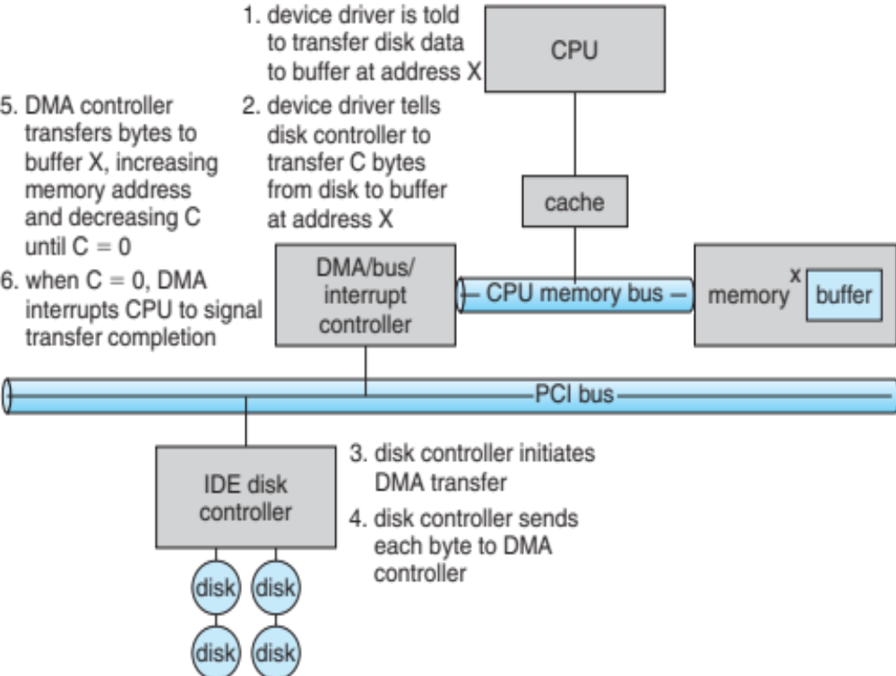
Six Step Process to Perform DMA Transfer

Slide 15
Application I/O Interface
I/O system calls encapsulate device behaviors in generic classes
Device-driver layer hides differences among I/O controllers from kernel
New devices talking already-implemented protocols need no extra work
Each OS has its own I/O subsystem structures and device driver frameworks
Devices vary in many dimensions
  Character-stream or block
  Sequential or random-access
  Synchronous or asynchronous (or both)
  Sharable or dedicated
  Speed of operation
  read-write, read only, or write only

Slide 16
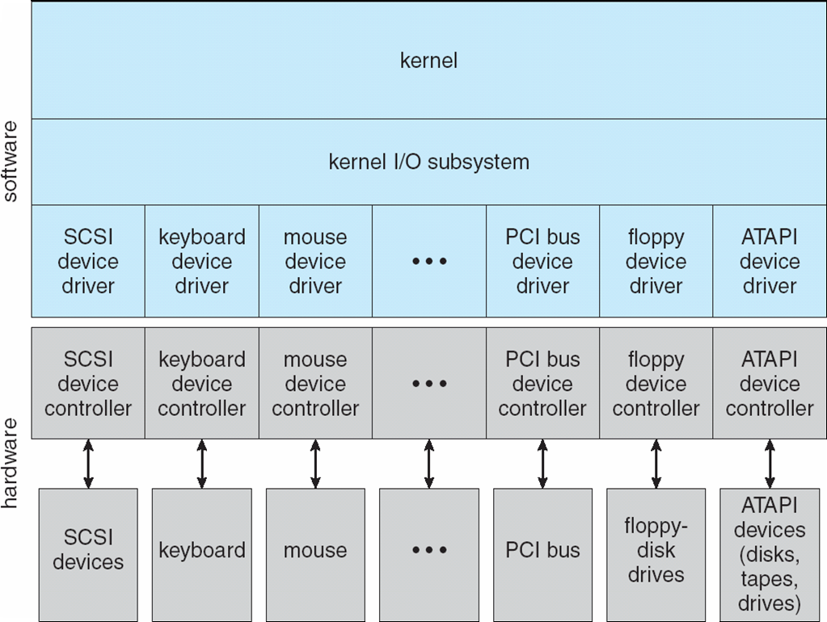
A Kernel I/O Structure

Slide 17
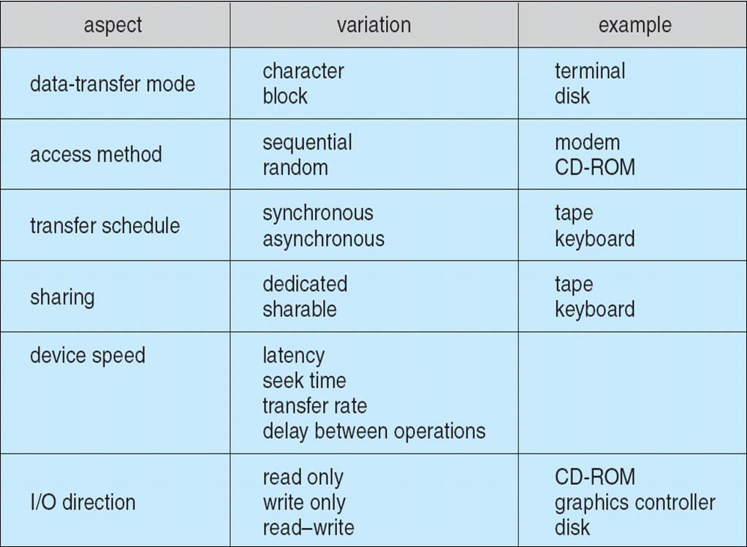
Characteristics of I/O Devices

Slide 18
Characteristics of I/O Devices (Cont.)
Subtleties of devices handled by device drivers
Broadly I/O devices can be grouped by the OS into
  Block I/O
  Character I/O (Stream)
  Memory-mapped file access
  Network sockets
For direct manipulation of I/O device specific characteristics, usually an escape / back door
  Unix ioctl() call to send arbitrary bits to a device control register and data to device data register

Slide 19
Block and Character Devices
Block devices include disk drives
  Commands include read, write, seek(random access)
  Raw I/O(access a block device as a simple linear array of blocks), direct I/O, or file-system access
  Memory-mapped file access possible
    File mapped to virtual memory and clusters brought via demand paging
  DMA
Character devices include keyboards, mice, serial ports
  Commands include get(), put()
  Libraries layered on top allow line editing(backspace, the preceding character is removed from the input stream)

Slide 20
Network Devices
Varying enough from block and character to have own interface
Linux, Unix, Windows and many others include socket interface
  Separates network protocol from network operation
  Includes select() functionality
Approaches vary widely (pipes, FIFOs, streams, queues, mailboxes)

Slide 21
Clocks and Timers
Provide current time, elapsed time, timer
Normal resolution about 1/60 second
Some systems provide higher-resolution timers
Programmable interval timer used for timings, periodic interrupts
ioctl() (on UNIX) covers odd aspects of I/O such as clocks and timers

Slide 22
Nonblocking and Asynchronous I/O
Blocking - process suspended until I/O completed(When an application issues a blocking system call, the execution of the application is suspended. The application is moved from the operating system’s run queue to a wait queue. After the system call completes, the application is moved back to the run queue, where it is eligible to resume execution.)
  Easy to use and understand
  Insufficient for some needs
Nonblocking - I/O call returns as much as available(A nonblocking call does not halt the execution of the application for an extended time. Instead, it returns quickly, with a return value that indicates how many bytes were transferred.)
  User interface, data copy (buffered I/O)
  Implemented via multi-threading
  Returns quickly with count of bytes read or written
  select() to find if data ready then read() or write() to transfer
Asynchronous - process runs while I/O executes(An asynchronous call returns immediately, without waiting for the I/O to complete. )
  Difficult to use
  I/O subsystem signals process when I/O completed

Slide 23
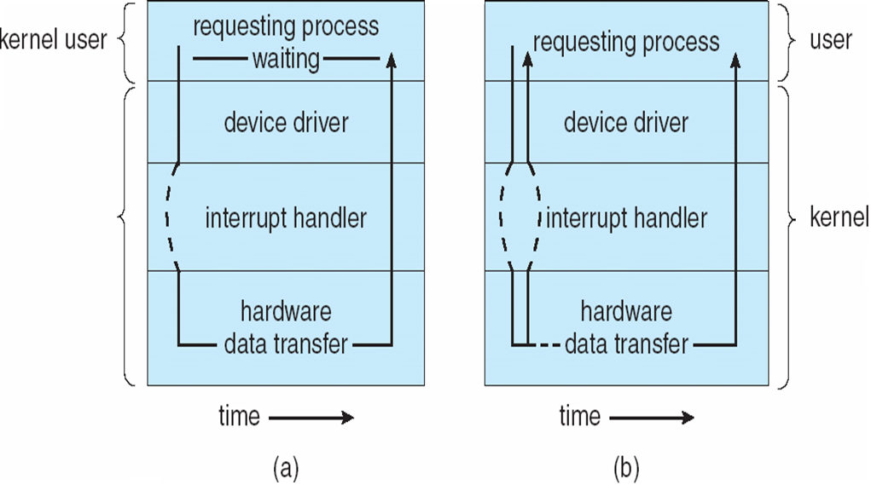
Two I/O Methods
Disk and network I/O are useful examples of Asynchronous activities .
Some I/O requests need to be performed immediately, should be performed synchronously.
Synchronous
Asynchronous

Slide 24
Vectored I/O
Vectored I/O allows one system call to perform multiple I/O operations involving multiple locations.
For example, Unix readve() accepts a vector of multiple buffers to read into or write from
This scatter-gather method better than multiple(several individual invocations of system calls) individual I/O calls
  Decreases context switching and system call overhead
  Some versions provide atomicity
    Avoid for example worry about multiple threads changing data as reads / writes occurring

Slide 25
Kernel I/O Subsystem
Scheduling can improve overall system performance, can share device access fairly among processes, and can reduce the average waiting time for I/O to complete. Some I/O request ordering via per-device queue.
  Some OSs try fairness
  Some implement Quality Of Service (i.e. IPQOS)
Buffering - store data in memory while transferring between devices
  To cope with device speed mismatch
  To cope with device transfer size mismatch
  To maintain “copy semantics”
  Double buffering – two copies of the data(decouples the producer of data from the consumer, thus relaxing timing requirements between them.)
    Kernel and user
    Varying sizes
    Full / being processed and not-full / being used
    Copy-on-write can be used for efficiency in some cases

Slide 26
Buffer Manegemnet
Reasons for Buffering:
  To cope with device speed mismatch(file is being received via modem for storage on the hard disk)
  To cope with device transfer size mismatch(a large message is fragmented into small network packets)
  To maintain “copy semantics”:
  (Suppose an application has a buffer of data that it wishes to write to disk. It calls the write() system call, providing a pointer to the buffer and an integer specifying the number of bytes to write. After the system call returns, what happens if the application changes the contents of the buffer? Using copy semantics version of the data written to disk is guaranteed to be the version at the time of the application system call, independent of any subsequent changes in the application’s buffer.)

Slide 27
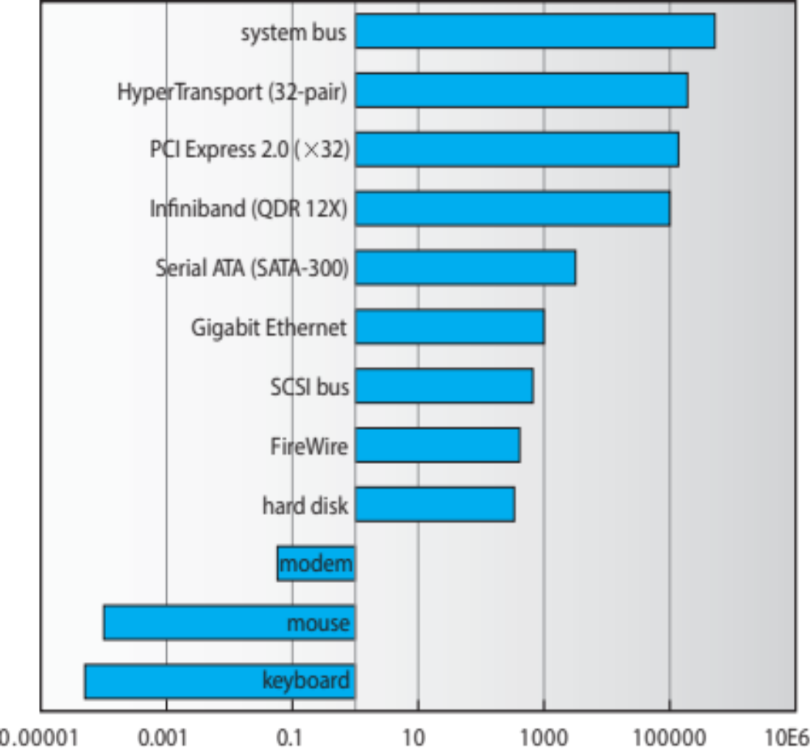
Need of double buffering-Sun Enterprise 6000 Device-Transfer Rates
Sun Enterprise 6000 device-transfer rates (logarithmic).

Slide 28
Caching and Spooling
Caching –(A cache is a region of fast memory that holds copies of data. ) faster device holding copy of data
  Always just a copy
  Key to performance
  Sometimes combined with buffering
Spooling – (A spool is a buffer that holds output for a device, such as a printer, that cannot accept interleaved data streams.) hold output for a device
  If device can serve only one request at a time
  i.e., Printing
  Each application’s output is spooled to a separate disk file. When an application finishes printing, the spooling system queues the corresponding spool file for output to the printer.
Device reservation - provides exclusive access to a device
  System calls for allocation and de-allocation
  Watch out for deadlock

Slide 29
Error Handling
Devices and I/O transfers can fail in many ways, either for transient reasons, as when a network becomes overloaded, or for “permanent” reasons, as when a disk controller becomes defective.
As a general rule, an I/O system call will return one bit of information about the status of the call, signifying either success or failure.
OS can recover from disk read, device unavailable, transient write failures
  Retry a read or write, for example
  Some systems more advanced – Solaris FMA, AIX
    Track error frequencies, stop using device with increasing frequency of retry-able errors
Most return an error number or code when I/O request fails
System error logs hold problem reports

Slide 30
I/O Protection
User process may accidentally or purposefully attempt to disrupt normal operation via illegal I/O instructions
  All I/O instructions defined to be privileged
  I/O must be performed via system calls
    Memory-mapped and I/O port memory locations must be protected too

Slide 31
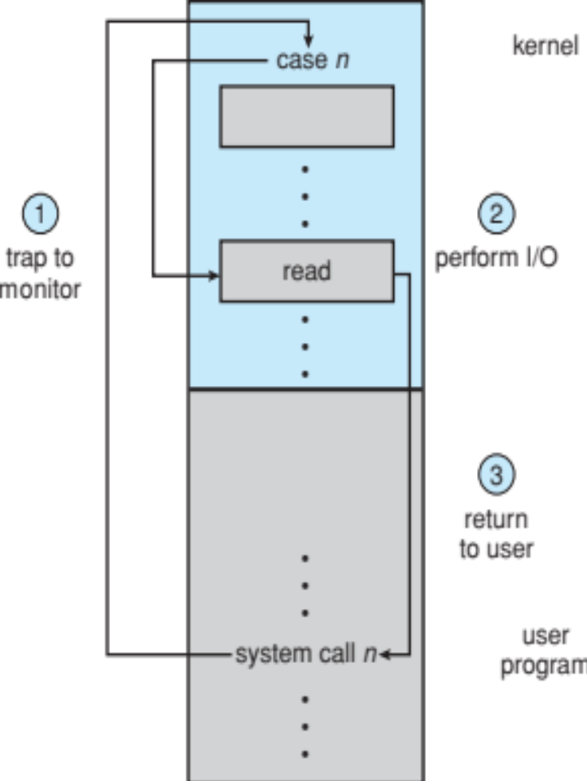
Use of a System Call to Perform I/O

Slide 32
I/O Requests to Hardware Operations
Consider reading a file from disk for a process:
  Determine device holding file
  Translate name to device representation
  Physically read data from disk into buffer
  Make data available to requesting process
  Return control to process

Slide 33
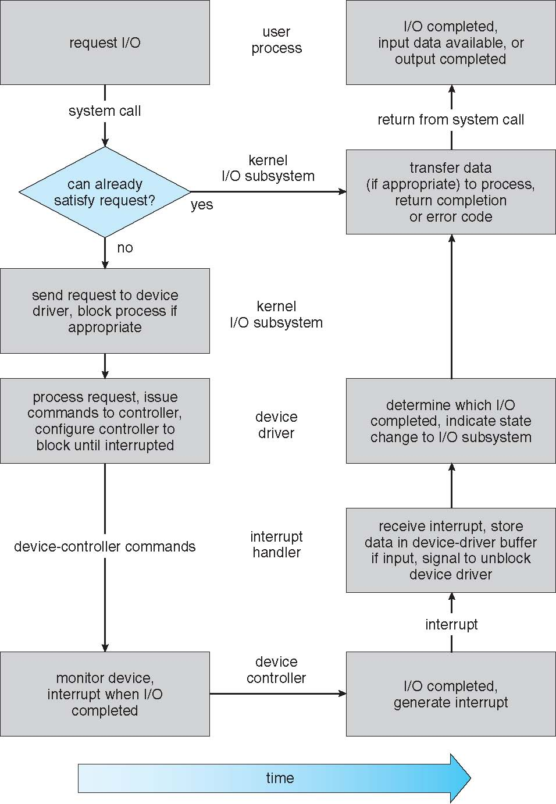
Life Cycle of An I/O Request

Slide 34
STREAMS
STREAM – a full-duplex communication channel between a user-level process and a device in Unix System V and beyond
A STREAM consists of:
  STREAM head interfaces with the user process
  driver end interfaces with the device
  zero or more STREAM modules between them
Each module contains a read queue and a write queue
Message passing is used to communicate between queues
  Flow control option to indicate available or busy
Asynchronous internally, synchronous where user process communicates with stream head

Slide 35
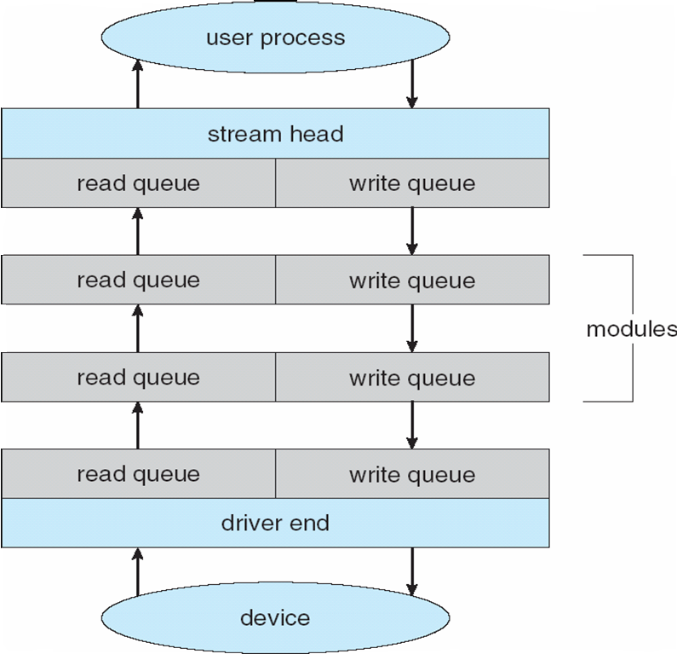
The STREAMS Structure

Slide 36
Performance
I/O a major factor in system performance:
  Demands CPU to execute device driver, kernel I/O code
  Context switches due to interrupts
  Data copying
  Network traffic especially stressful

Slide 37
Improving Performance
Reduce number of context switches
Reduce data copying
Reduce interrupts by using large transfers, smart controllers, polling
Use DMA
Use smarter hardware devices
Use separate front-end processors for terminal I/O to reduce the interrupt burden on the main CPU.
Balance CPU, memory, bus, and I/O performance for highest throughput
Move user-mode processes / daemons to kernel threads

Slide 38
Improving efficiency of I/O
Reduce the number of context switches.
Reduce the number of times that data must be copied in memory while passing between device and application.
Reduce the frequency of interrupts by using large transfers, smart controllers, and polling (if busy waiting can be minimized).
Increase concurrency by using DMA-knowledgeable controllers or channels to offload simple data copying from the CPU.
Move processing primitives into hardware, to allow their operation in device controllers to be concurrent with CPU and bus operation.
Balance CPU, memory subsystem, bus, and I/O performance, because an overload in any one area will cause idleness in others.

